Slide 1
Azure Batch and Azure Batch Shipyard
Microsoft Research

Slide 2
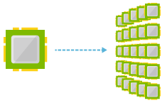
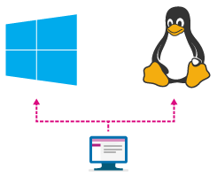
Batch Service
Cloud-scale job scheduling and compute management scaling to thousands of virtual machines for cloud-enabled batch and HPC applications
Stage data and execute compute pipelines
Choose Linux, Linux with Docker, or Windows
Notes:
A virtual machine is -- well -- a virtualized machine created and managed by a hypervisor such as VirtualBox or Hyper-V. Even though a VM runs on a machine that has an operating system, each VM requires its own complete operating system, even if it's the same operating system as the host OS. VMs offer a very high degree of isolation, but at a cost: longer startup times, lower portability (ever tried to move a 127 GB virtual hard disk, or VHD, from one PC to another?), and higher memory requirements. Containers, by contrast, leverage the operating system that is already in place but offer nearly as much separation. RAM requirements are lower since the OS isn't being duplicated in each container, and cost is lower, too, because while cloud platforms typically charge for each VM, a single VM can host multiple container instances.

Slide 3
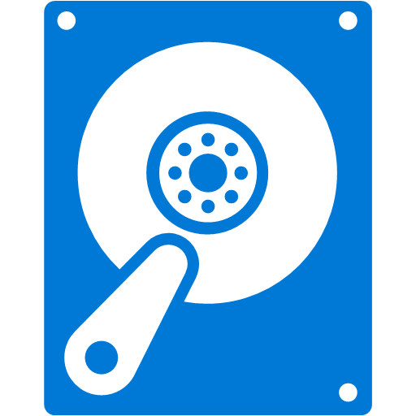

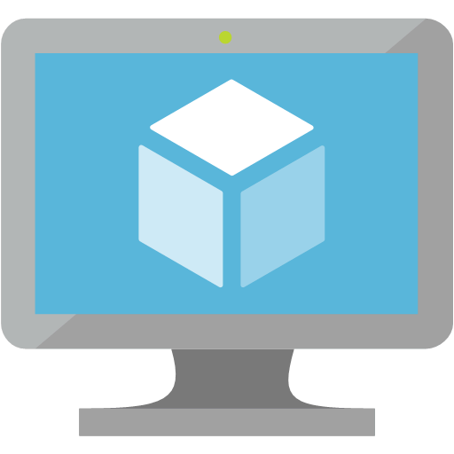
Batch Service
Storage
Batch on Azure uses three major components: Storage, Jobs, and Pools
Storage is where batch data is stored for input and output
Jobs are the software components that operate on input data from Storage
Pools are composed of compute resources including RAM, CPUs, and GPUs
Jobs
Pools
Notes:
Batch on Azure orchestrates many of the already existing components on Azure to make up the major components: Storage, Jobs, and Pools. Storage uses Azure Storage Accounts for data input and data output for batch jobs. Jobs themselves are composed of tasks, witch each task performing some distinct aspect of a job. Pools are Azure Virtual Machines that receive the tasks from the jobs and run the them. Some of the types of compute resource can even be GPU’s. Some of the batch jobs written for GPU’s can be processed on NVIDIA Cuda cores, which that usually number in the hundreds per machine. These are available on Azure N-series VM’s

Slide 4
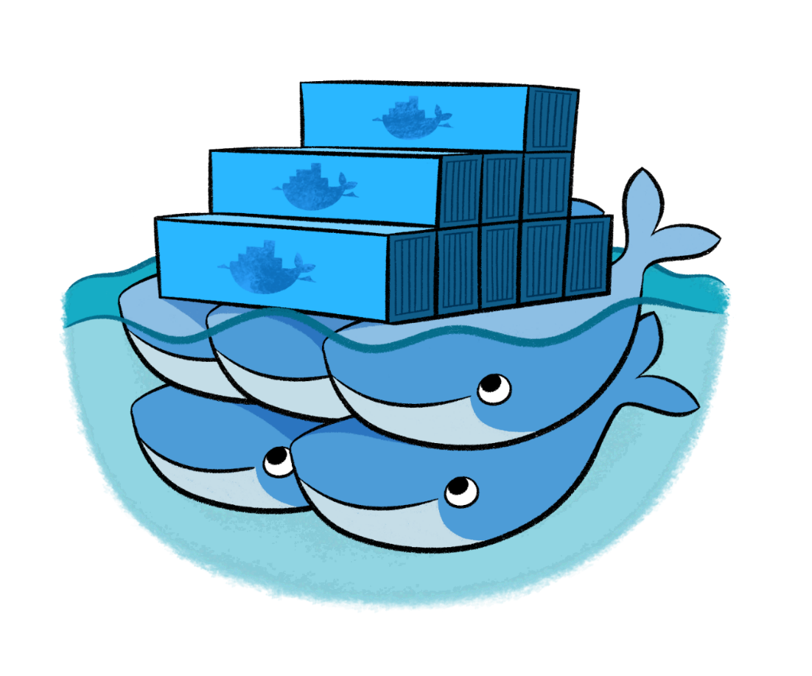
Batch Shipyard
Batch Shipyard is an open-source utility that allows Batch users to use Docker containers as tasks on jobs instead of loading the jobs directly on the operating system for the compute nodes
“Docker containers wrap a piece of software in a complete filesystem that contains everything it needs to run: code, runtime, system tools, system libraries – anything you can install on a server. This guarantees that it will always run the same, regardless of the environment it is running in.”
Notes:
Batch Shipyard is a utility that allows Docker Containers to be used to run tasks instead of tasks being loaded directly onto the virtual machines in a pool. Docker by design allows all the software and software dependencies for an application to be housed in the container, and it is carried along with the container wherever it goes. Likewise, this allows containers to be scaled out massively. Once a container is built, it can be copied over and over. Likewise, the cleanup is easy. Once they are used, they can be discarded. This makes them ideal for running massive batch jobs.

Slide 5
Containers
Lightweight alternative to virtual machines
Smaller, less costly, faster to start, and self-contained
Virtual Machines
App
App
App
Libraries
Libraries
Libraries
Containers
Guest OS
Guest OS
Guest OS
App
App
App
Libraries
Libraries
Libraries
Hypervisor
Container Engine
Host Operating System
Operating System
Notes:
Containers, leverage the operating system that is already in place but offer nearly as much separation. RAM requirements are lower since the OS isn't being duplicated in each container, and cost is lower, too, because while cloud platforms typically charge for each VM, a single VM can host multiple container instances. In a Batch scenario, this makes isolating multiple instance of single threaded applications on a VM with multiple cores easy. This is not always possible on single-threaded applications running in a common operating environment.

Slide 6
Batch Recipes
Batch Shipyard is built on Python
Batch Shipyard uses JSON config files to configure Batch Shipyard, storage, and jobs
A combination of the Dockerfile used to build images for containers and these config files constitute a “recipe”
Notes:
Batch Service recipes are set of Batch Shipyard config files and the associated Dockerfiles used to build the Docker containers on the Batch Service. The four files include a credentials files that supplies the keys and passwords to connect to the services on Azure. The pools file contains the definitions for the size of the pools to run the jobs. The jobs file the definition of the job to rub on the pool. Each job has one or more tasks that reference a Docker container. Lastly, the main config file contains the global settings for the recipe.

Slide 7
The Dockerfile
Before a Batch Shipyard job can be run, a container image must be built using a Dockerfile
The Dockerfile contains instructions that tell Docker how to build an image
Once an image is built, it can be pushed to Docker Hub for use
FROM ubuntu
MAINTAINER MSR
ADD text2ogg.sh /text2ogg.sh
RUN apt-get update && \
apt-get install -y espeak vorbis-tools && \
chmod +x text2ogg.sh && \
mkdir /fileshare
CMD ["sh" "text2ogg.sh"]
Notes:
Dockerfiles are the secret sauce in containers. These files contain instructions that Docker uses to build and image. Once Docker has built the image, the image can be pushed to Docker Hub (or another, private repository) for use. Batch Shipyard tells a Batch Service where the image for a particular task lives. Batch Services will then pull the image and deploy the image one or more times as a container.

Slide 8

The Batch Workflow
Storage
Create a pool
Provision storage
Create and run a job
Tasks read from storage
Tasks write results to storage
Results are downloaded and viewed
Jobs
Pools
Notes:
The Batch Workflow requires a lot of work upfront to set up the batch to run. After container is built, then the batch service has be setup using Batch Shipyard to create pools and the input data has to be front loaded for the Jobs to read. Once the front-end work is done, the rest is automated for the batch processes. With work flows that are going to be run periodically though, even the front end work can be automated using Batch Shipyard because it is a scriptable tool. Other Azure tools and API’s like those for storage accounts can be used to build out other automations in conjunction with Batch Shipyard to get full automation of a particular job.

Slide 9
Batch Shipyard
Dockerfiles
Batch Shipyard
Become a Batch Ninja
Batch Shipyard is available on GitHub, and has a number of prebuilt recipes and lots of documentation for getting started
In addition to learning Batch Shipyard, learning some of the basics about Dockerfiles and how they work is most helpful
Notes:
Batch Shipyard, while a very useful tool, does have a slight learning curve considering the broad swath of technologies it uses to bring it to life. Batch Shipyard on GitHub has provided a number of simple recipe that can serve as a starting place for using Batch Shipyard. Additionally, there is a quickstart guide and rich documentation to help get things up in running.

Slide 10
Hands-On Lab
Batch with Batch Shipyard
Azure Batch HOL.html

